Slide 1
React JS
Prepared by: Vijaya Tiple

Slide 2
Introduction
React is a front-end library developed by Facebook. It is used for handling the view layer for web and mobile apps. React JS allows us to create reusable UI components. It is currently one of the most popular JavaScript libraries and has a strong foundation and large community behind it.
It encourages the creation of reusable UI components, which present data that changes over time. Lots of people use React as the V in MVC.
React abstracts away the DOM from you, offering a simpler programming model and better performance.

Slide 3
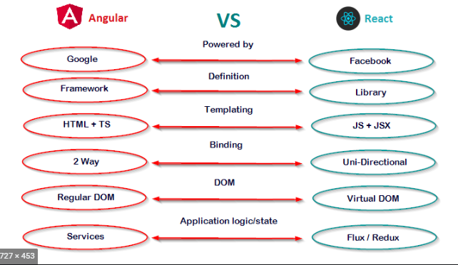
React vs Angular

Slide 4
Prerequisites
If you want to work with React JS, you need to have solid knowledge of JavaScript, HTML5, and CSS.
Even though React JS doesn't use HTML, the JSX is similar so your HTML knowledge will be very helpful.
Node should be installed on your machine.
Gitbash should be installed on your machine.
Visual studio code should be installed on your machine.

Slide 5
Getting Started
Create React App is an officially supported way to create single-page React applications. It offers a modern build setup with no configuration.
npx create-react-app my-app
cd my-app
npm start
If you've previously installed create-react-app globally via npm install -g create-react-app, we recommend you uninstall the package using npm uninstall -g create-react-app to ensure that npx always uses the latest version.
Then open http://localhost:3000/ to see your app.
When you’re ready to deploy to production, create a minified bundle with npm run build.

Slide 6
React Features
JSX − JSX is JavaScript syntax extension. It isn't necessary to use JSX in React development, but it is recommended.
Components − React is all about components. You need to think of everything as a component. This will help you maintain the code when working on larger scale projects.
Unidirectional data flow and Flux − React implements one-way data flow which makes it easy to reason about your app. Flux is a pattern that helps keeping your data unidirectional.

Slide 7
React Limitations
Covers only the view layer of the app, hence you still need to choose other technologies to get a complete tooling set for development.
Uses inline templating and JSX, which might seem awkward to some developers.

Slide 8
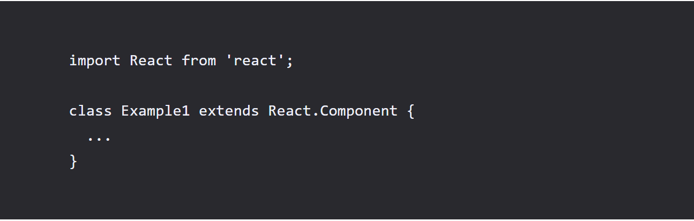
Types of component
1. Class based component:
To create a class component, we will have to give it a name. In the code below, we will call our class component "Example". All of our code for the component will go where the ellipsis ("...") is.
It should be noted that if this is a component in a file of it's own, it will have to be exported.

Slide 9
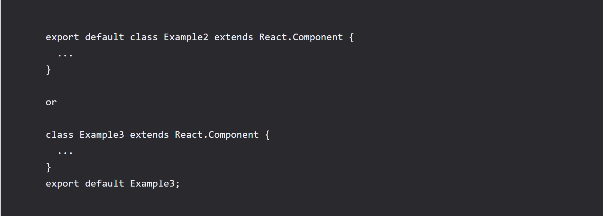
Exporting a class based component
There are two ways to do this. We can either include "export default" before our class instantiation or we can simply put a line after the class that exports it. The examples of this are below:

Slide 10
2. Stateless functional component:
React introduced a simpler way to define components called stateless functional components.
Stateless functional components are useful for dumb/presentational components.
Presentational components focus on the UI rather than behavior, so it’s important to avoid using state in presentational components. Instead, state should be managed by higher-level “container” components, or via Flux/Redux/etc.
Stateless functional components don’t support state or lifecycle methods. This is a good thing. Why? Because it protects from laziness.
These components use plain JavaScript functions. Here’s the before and after in ES6:

Slide 11
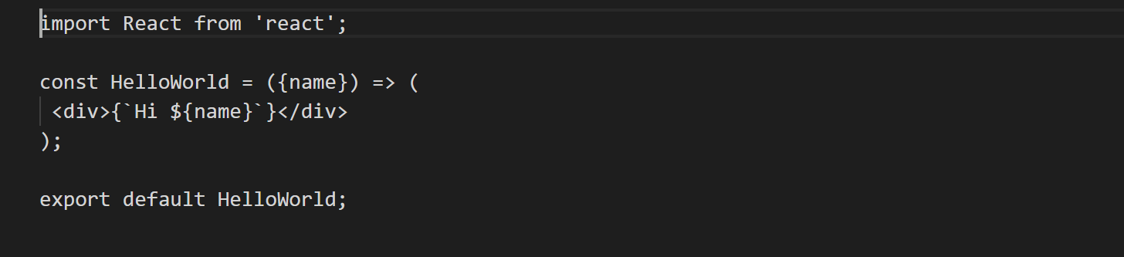
Stateless functional component example

Slide 12
Assignment
Create any 6 class based components of animals.
Each component must contain an animal name wrapped in h3 and its description in p tag
Create any 6 functional components of birds
Each component must contain the bird name wrapped in h3 and its description in p tag
Display them in a class based component Kingdom

Slide 13
Thank you!

